Slide 1
Environment Mapping - Reflection
Name: Shizhe Bao

Slide 2
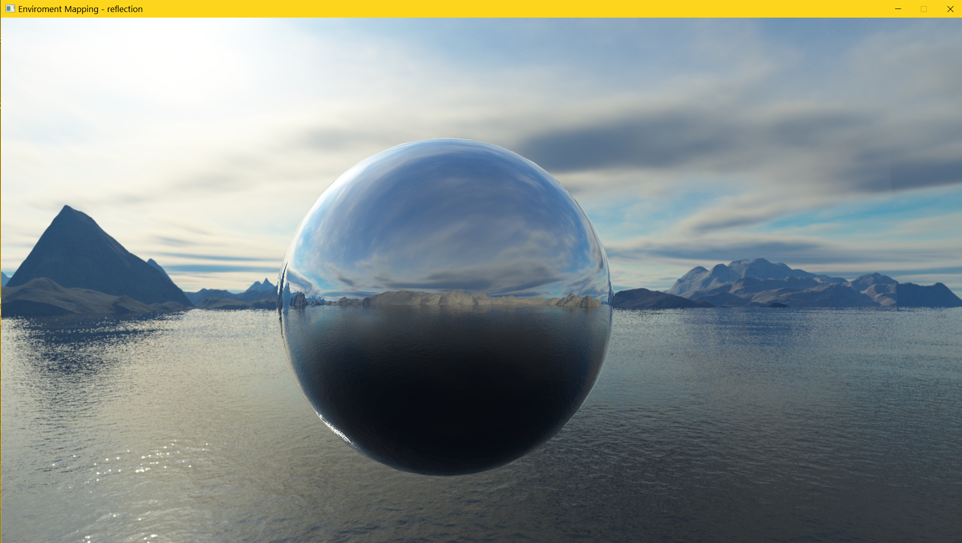
Demo

Slide 3
Main :: Section-1
Model objModel;
if (!objModel.loadModel("sphere.obj")) //load sphere.obj
{
glfwTerminate();
std::system("pause");
return -1;
}

Slide 4
Main :: Section-2
// 6 faces of box
std::vector<const char*> faces;
faces.push_back("sky_rt.jpg");
faces.push_back("sky_lf.jpg");
faces.push_back("sky_up.jpg");
faces.push_back("sky_dn.jpg");
faces.push_back("sky_bk.jpg");
faces.push_back("sky_ft.jpg");
SkyBox skybox;
skybox.init(faces);

Slide 5
Main :: Section-3
Shader shader("scene.vertex", "scene.frag"); // Reflection
Shader skyBoxShader("skybox.vertex", "skybox.frag"); // Background

Slide 6
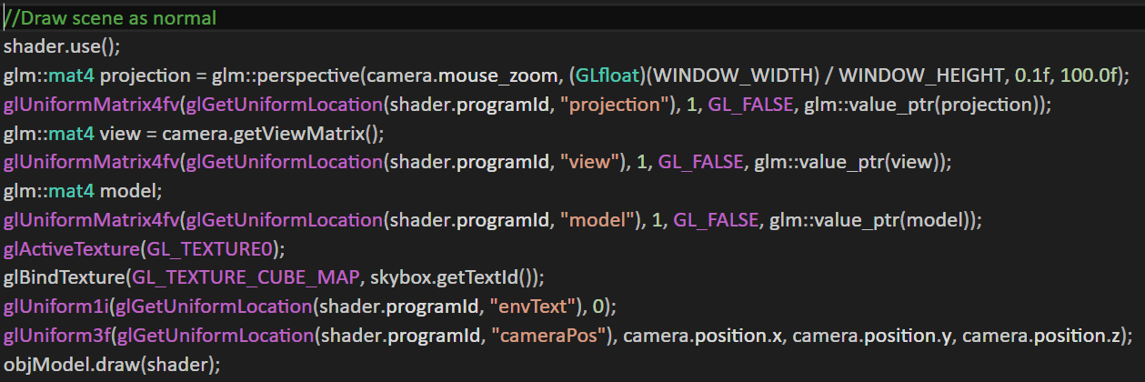
Draw scene

Slide 7
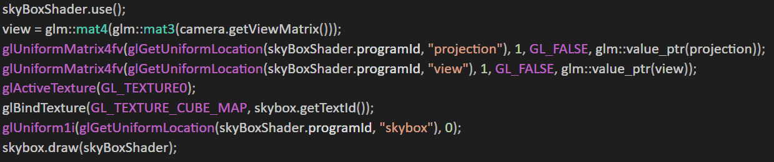
Draw Skybox

Slide 8
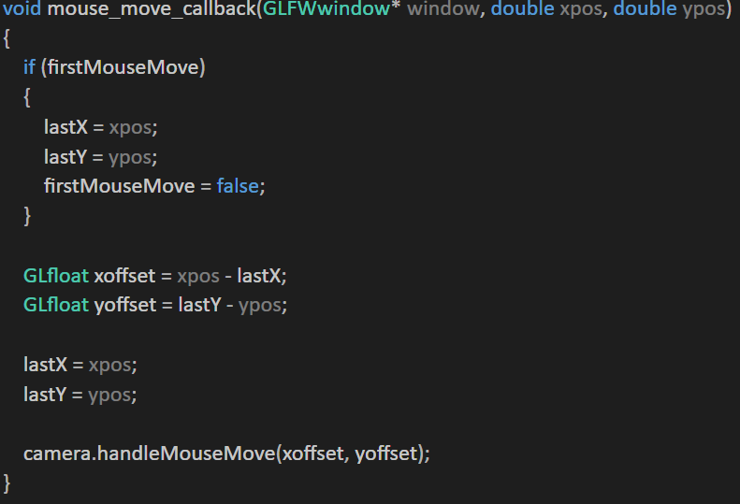
Action1: mouse_move_callback

Slide 9
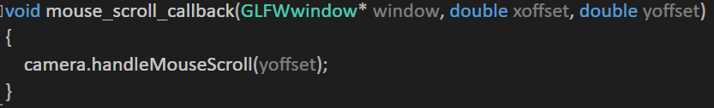
Action2: mouse_scroll_callback

Slide 10
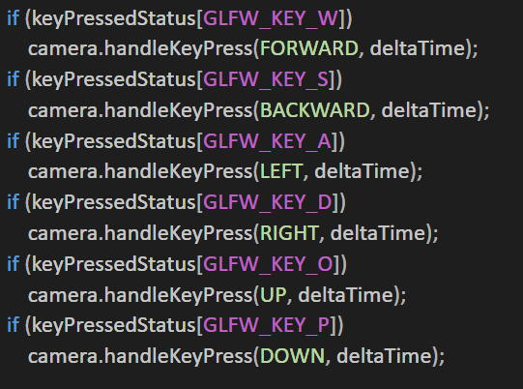
Action3: key_callback

